Slide 1
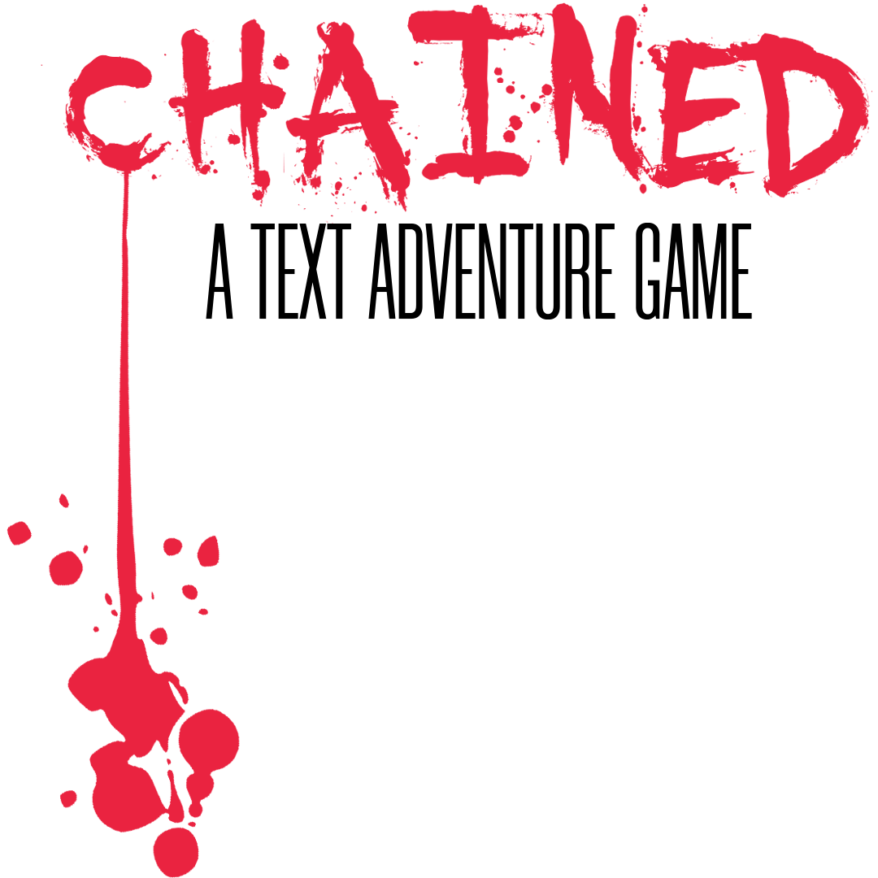
CSC1030 – Web Technologies Group 30
CSC1030 – Web Technologies Group 30
Allen Dungo – 40253397
Ross Martin – 40263403
Lance Nieva – 40266751
Christian Kho - 40263408
Allen Dungo – 40253397
Christian Kho - 40263408
Lance Nieva – 40266751
Ross Martin – 40263403

Slide 2
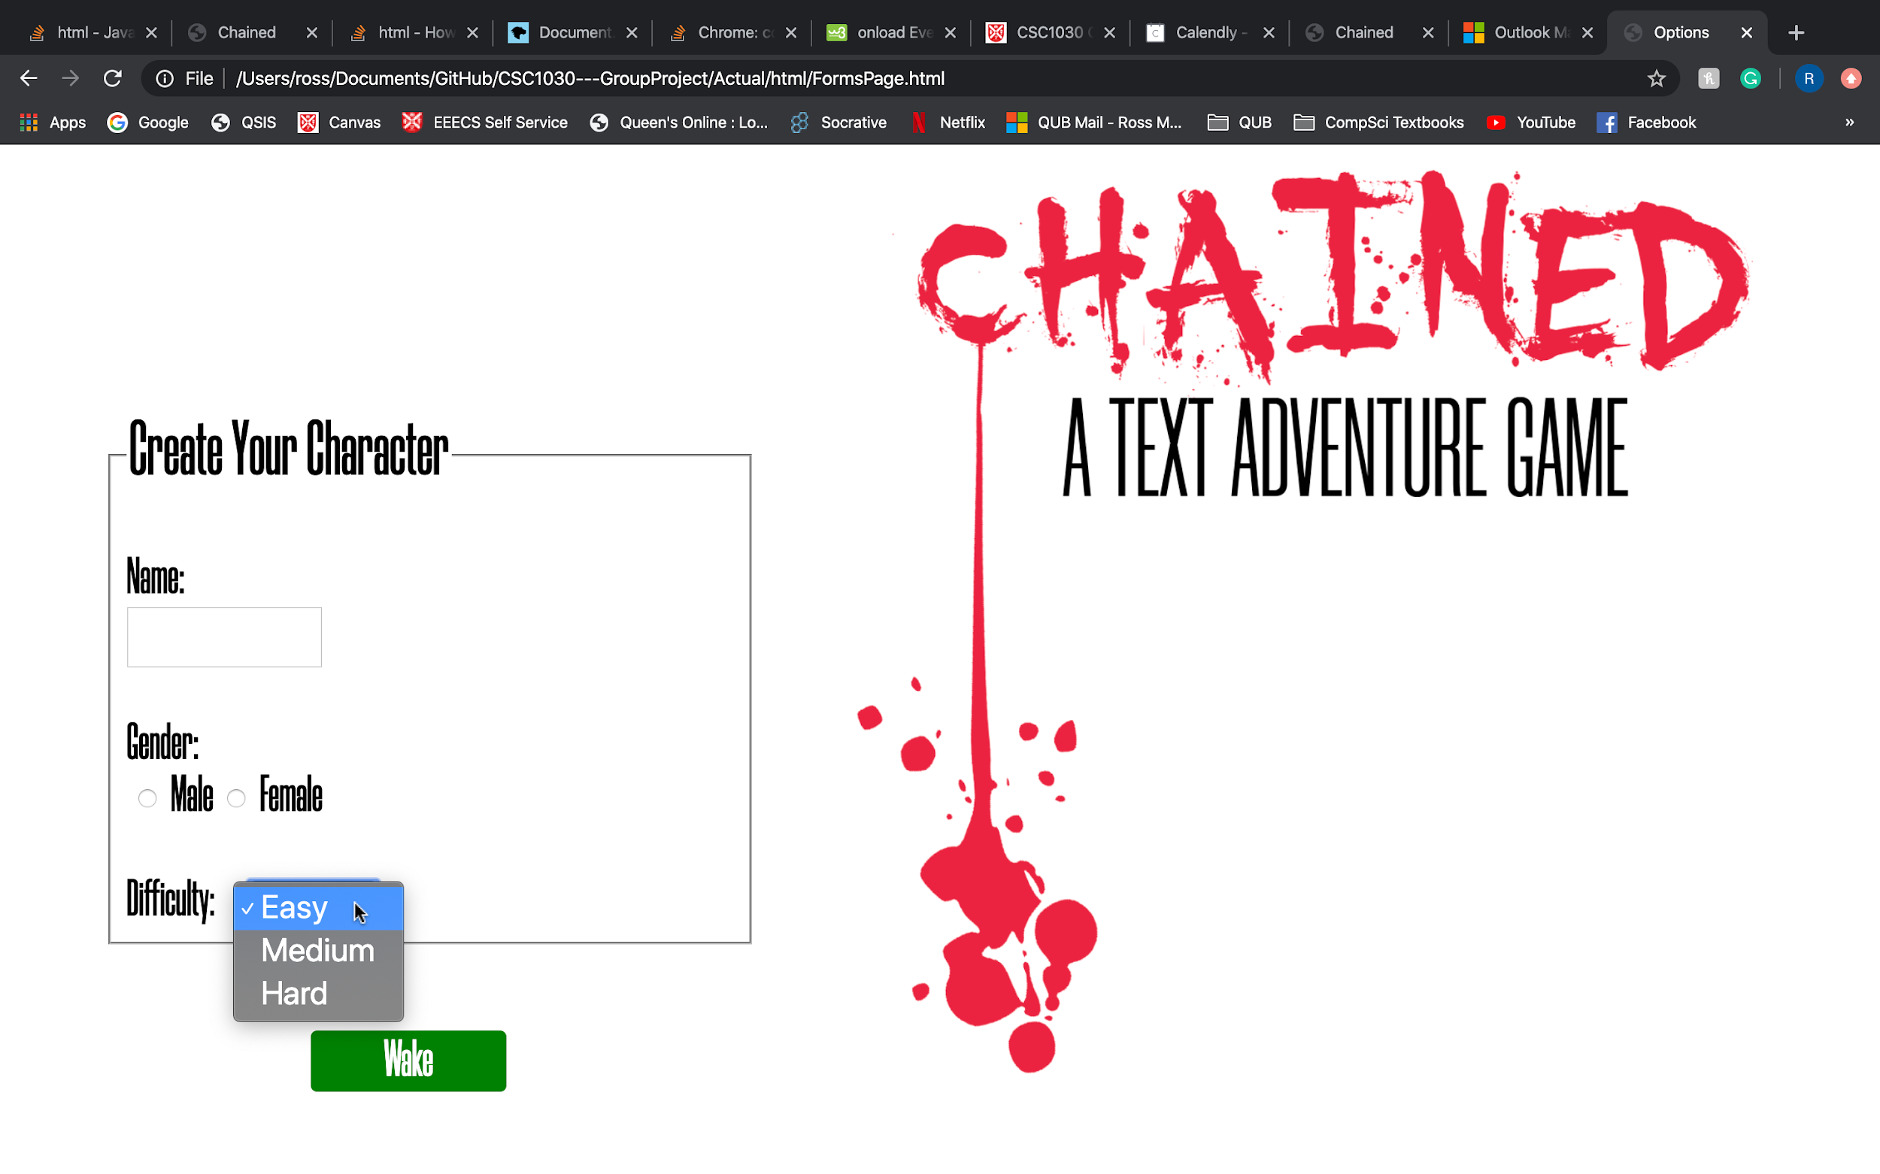
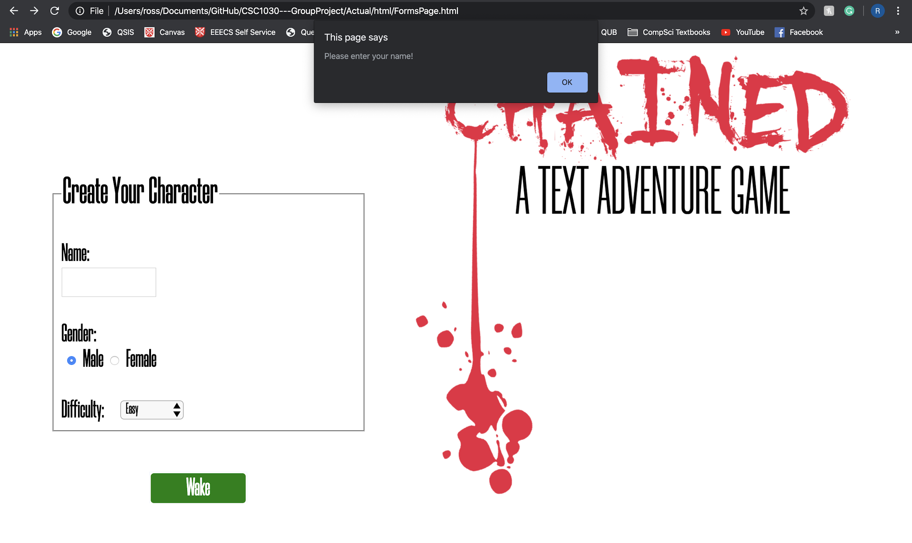
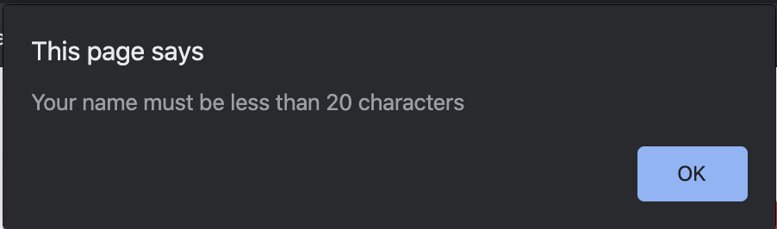
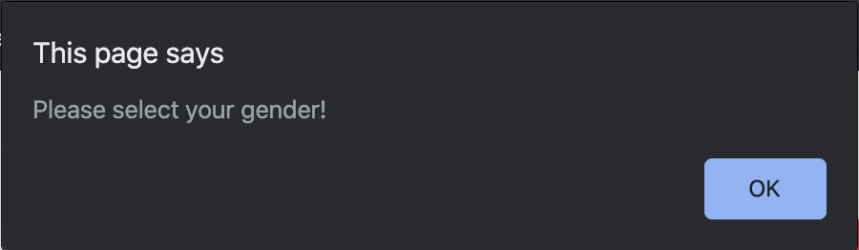
Text input for name - limited to 20 chars.
All data that is collected is stored in session storage to be used later on in the game.
We have included validation to ensure the player enters all required information.
The screenshots show the prompt given to the user when they do not complete the form correctly.
Set of radio buttons to select gender.
Dropdown list to select difficulty.
Collection of data using an HTML form

Slide 3
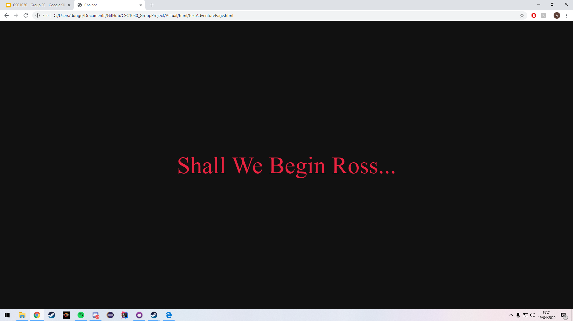
The harder the difficulty selected by the player, the shorter time they have to complete the adventure:
Easy – 60 seconds
Medium - 45 seconds
Hard – 30 seconds
Users time left is represented in textual and in a time-bar format
The characters name displayed before the adventure begins
How HTML form data has been used to personalise the game

Slide 4
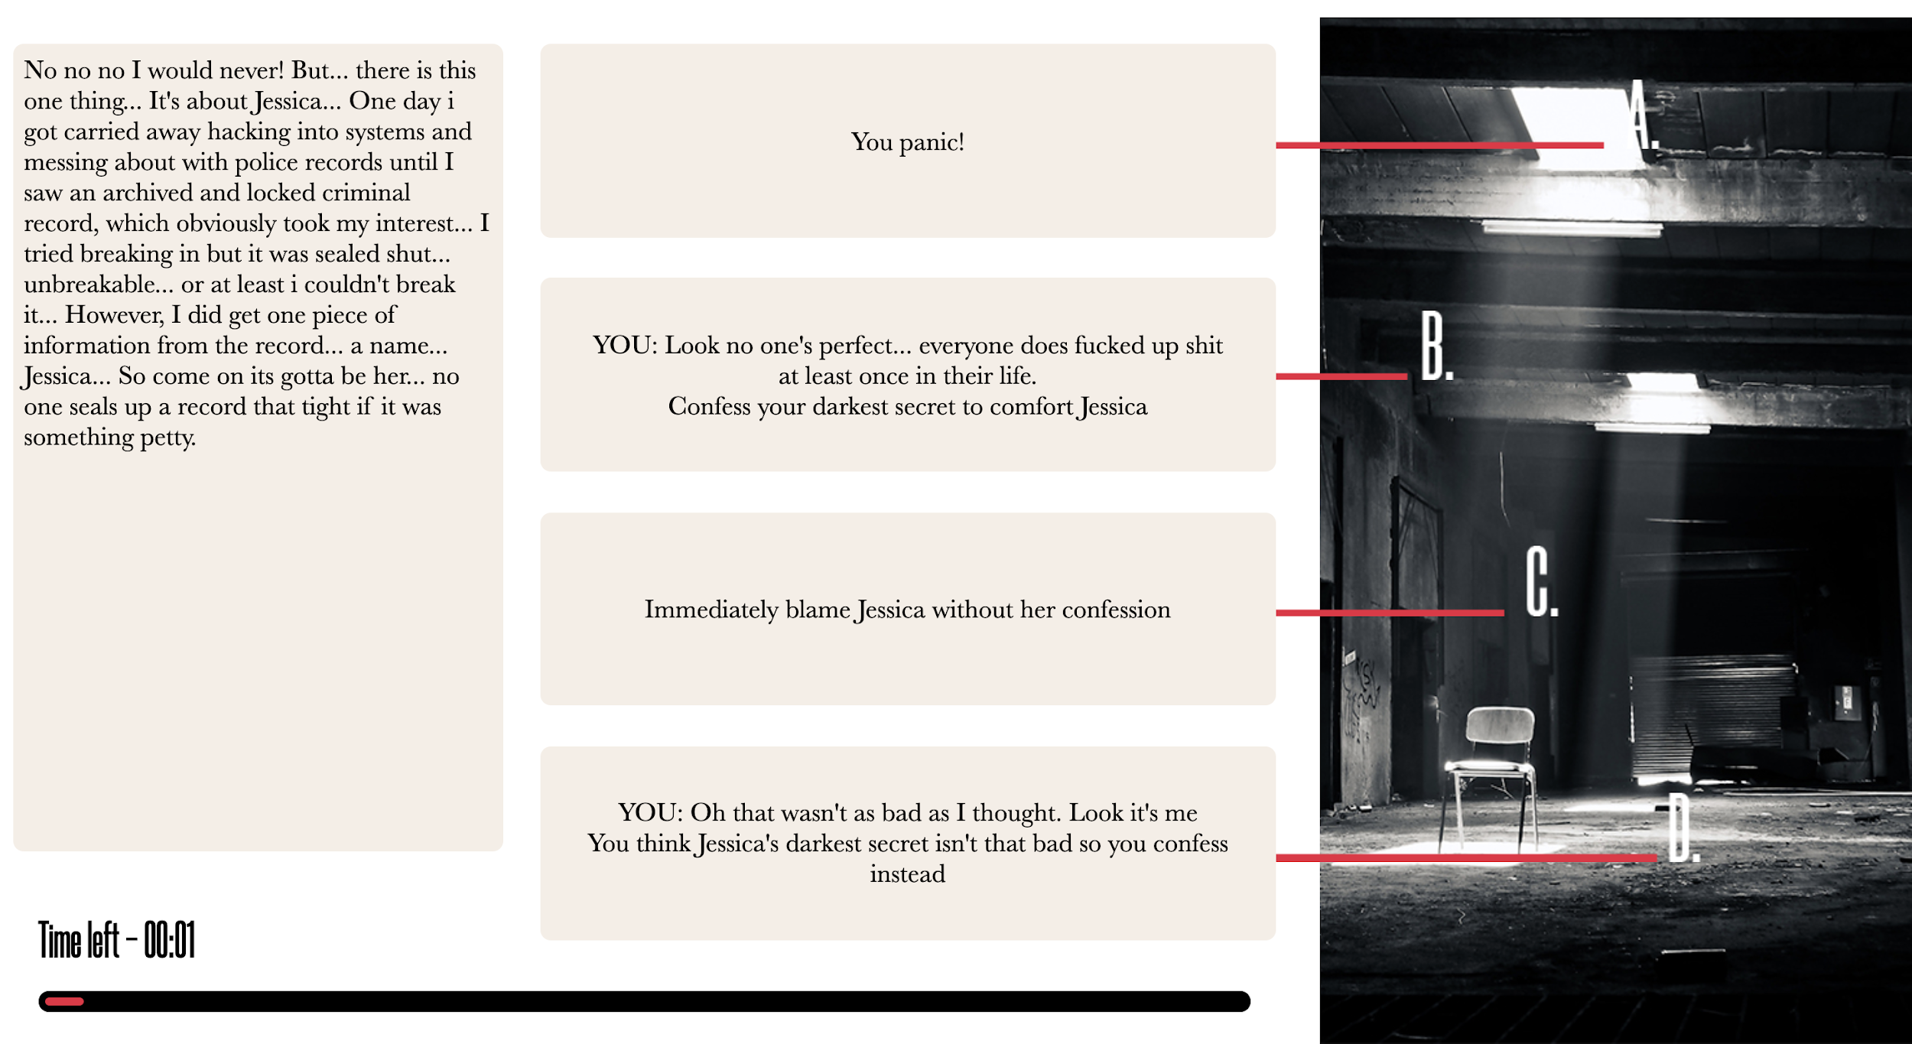
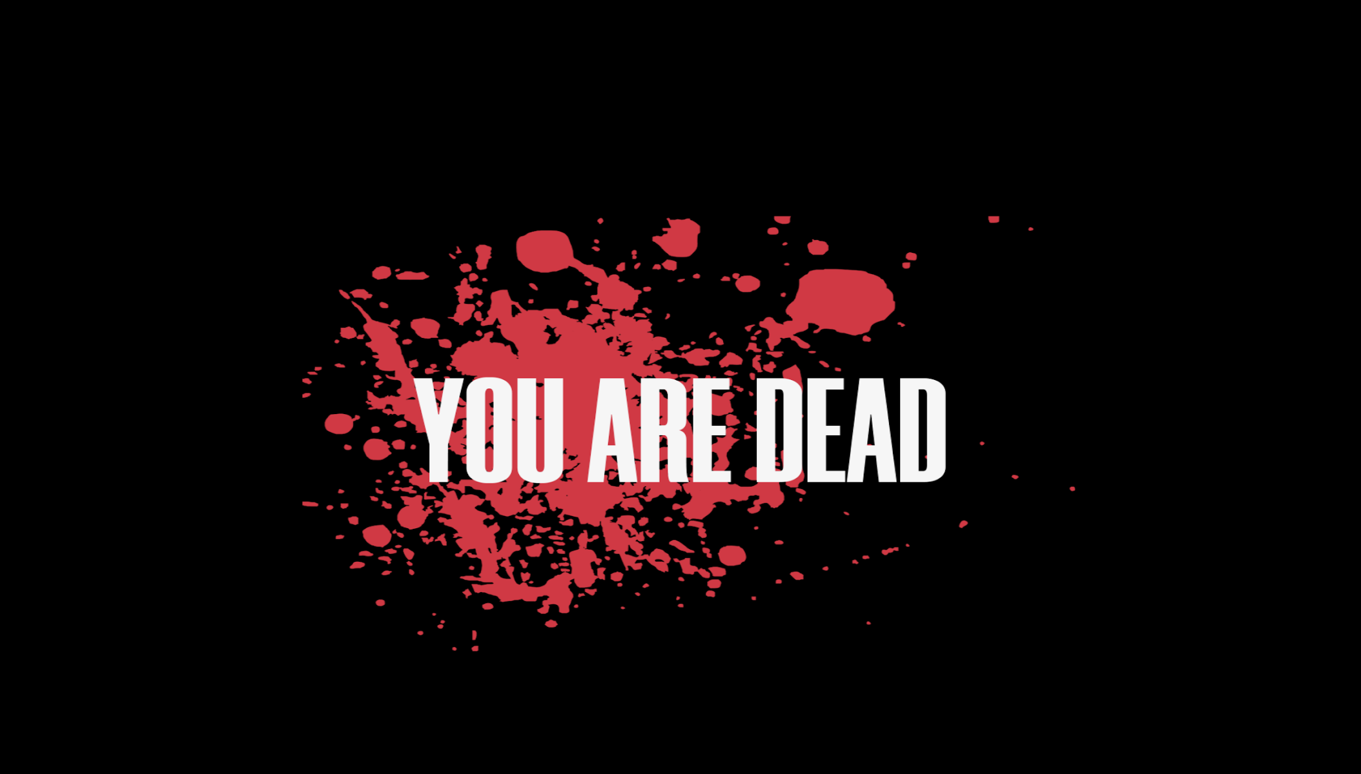
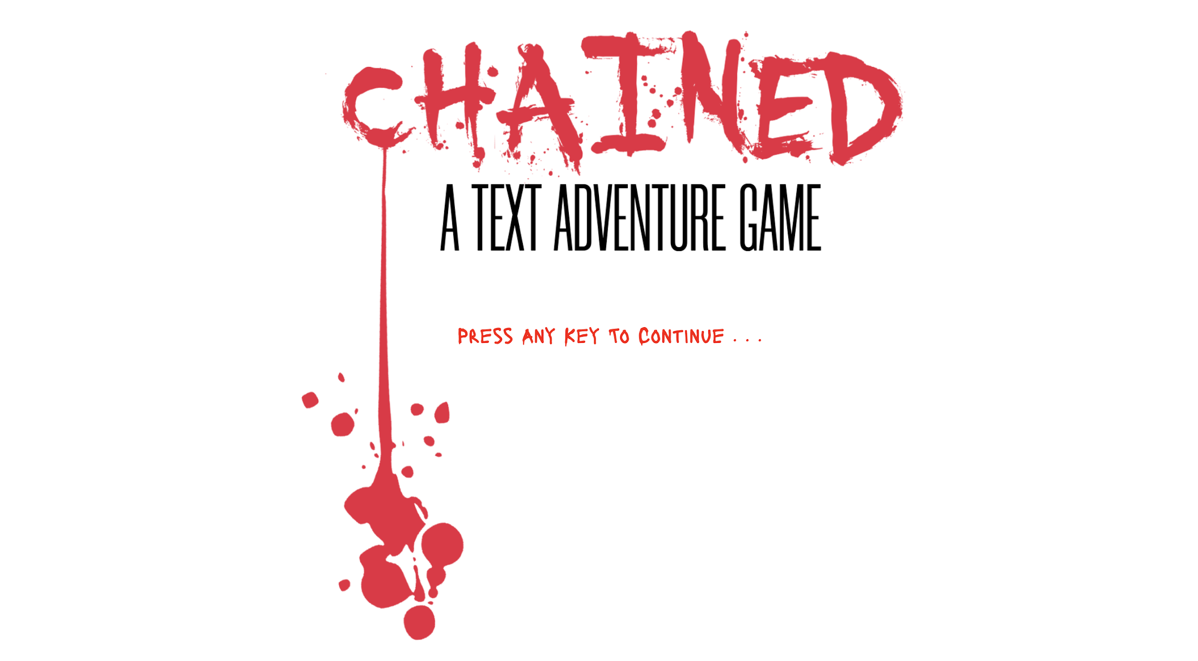
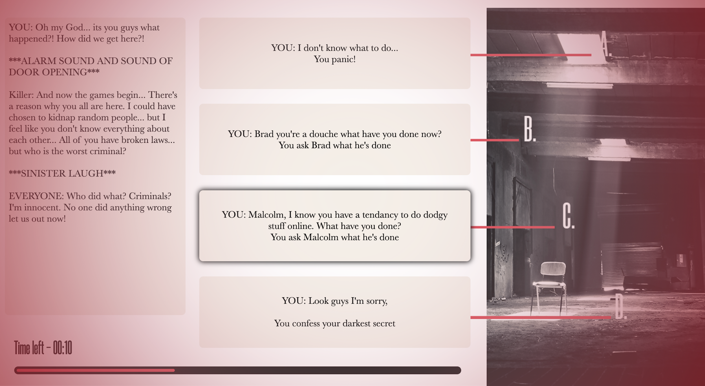
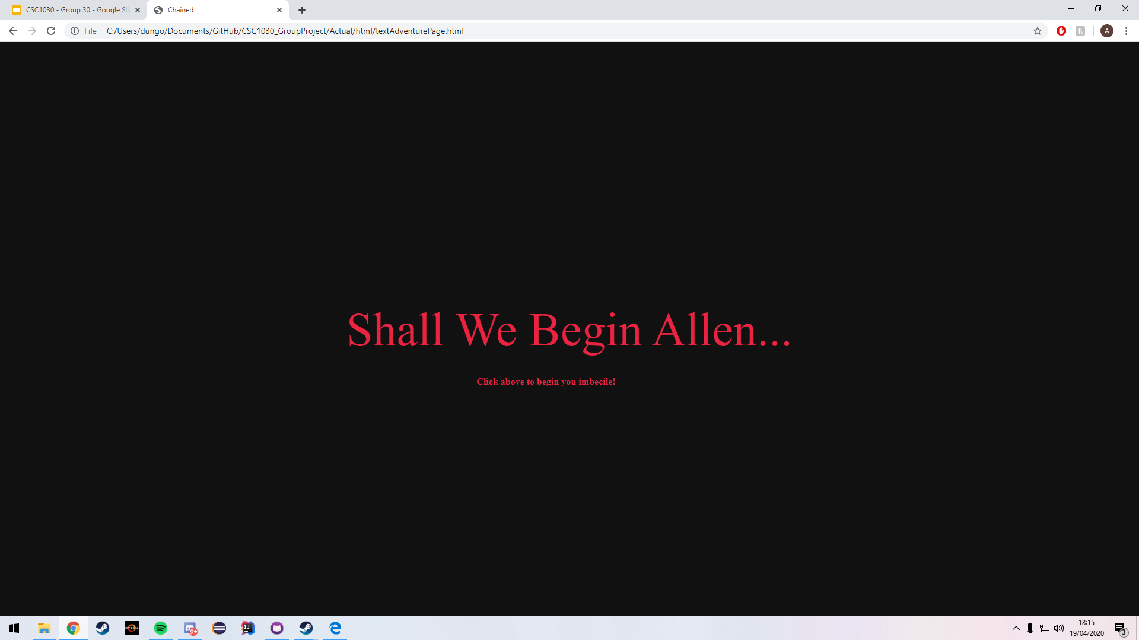
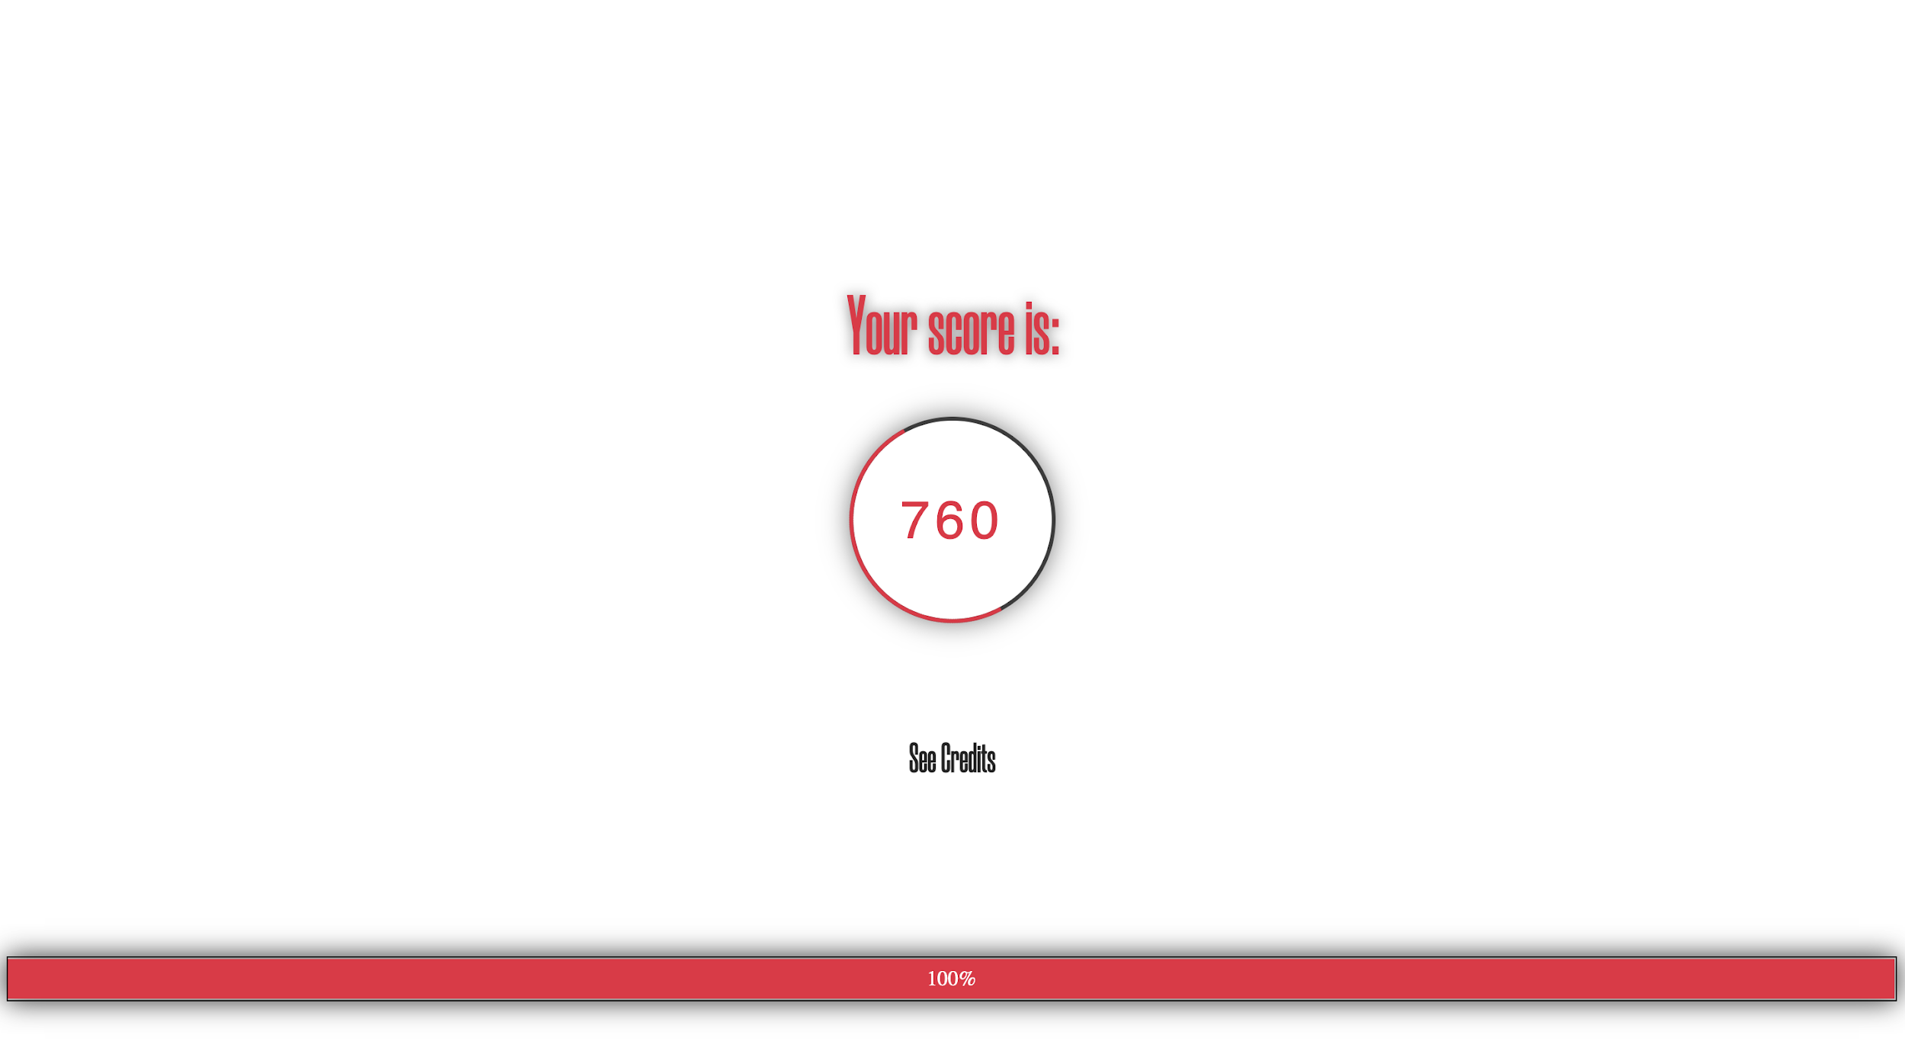
At each stage of our game if the user runs out of time, the game automatically finished. “You are Dead” screen appears.
When our player hits 15s, 10s and 5s of time remaining a red vignette fades into background with increasing strength.
A prompt appears after 3 seconds to tell the user to press any key to continue onto menu page.
A prompt appears after 3s if the user doesn’t click the text.
After the “You are Dead” screen fades out the Score and the progress percent appears.
Operation of JavaScript timed events

Slide 5
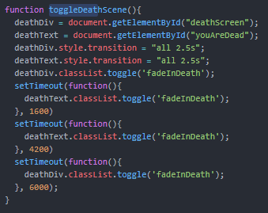
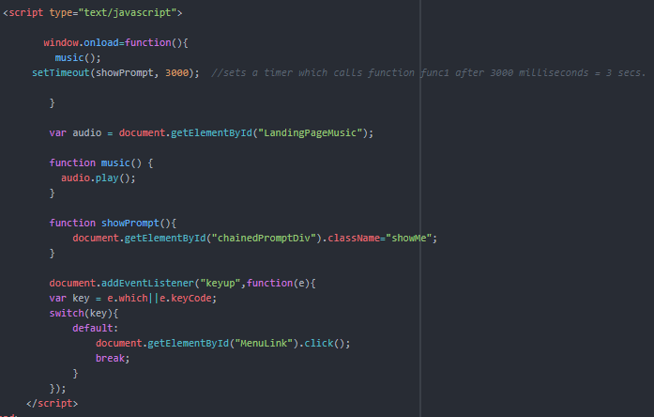
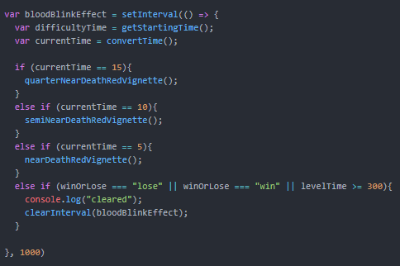
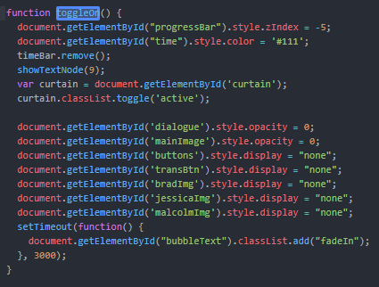
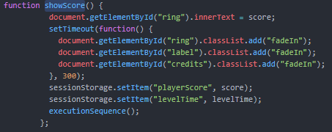
At each stage of our game if the user runs out of time, the game automatically finished. “You are Dead” screen appears.
A prompt appears after 3 seconds to tell the user to press any key to continue onto menu page.
When our player hits 15s, 10s and 5s of time remaining a red vignette fades into background with increasing strength.
A prompt appears after 3s if the user doesn’t click the text.
After the “You are Dead” screen fades out the Score and the progress percent appears.
Operation of JavaScript timed events (Code Snippets)

Slide 6
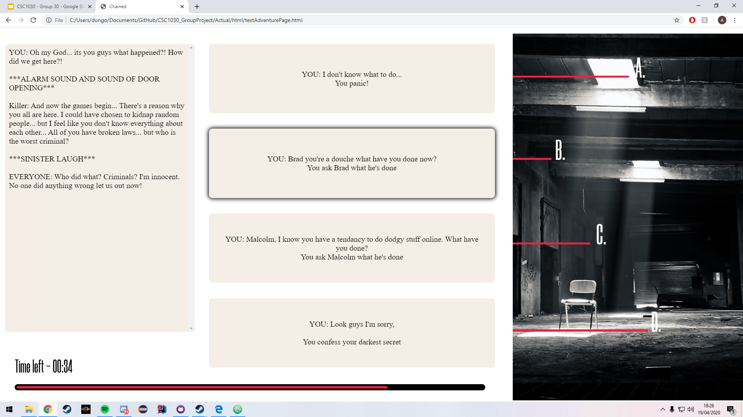
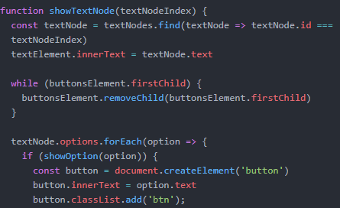
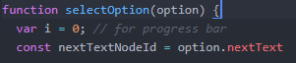
This function adds the corresponding text in the dialogue and buttons using text node IDs, then when an option is clicked, it removes the current text/buttons and shows the next corresponding text/buttons based on the option selected.
This function allows us to edit what happens in a specific text node such as silhouettes appearing when characters are introduced.
The showTextNode() function is called within selectOption() to show the next corresponding text node which is specified as a parameter in the selectOption() parameter.
Operation of text adventure elements (1)

Slide 7
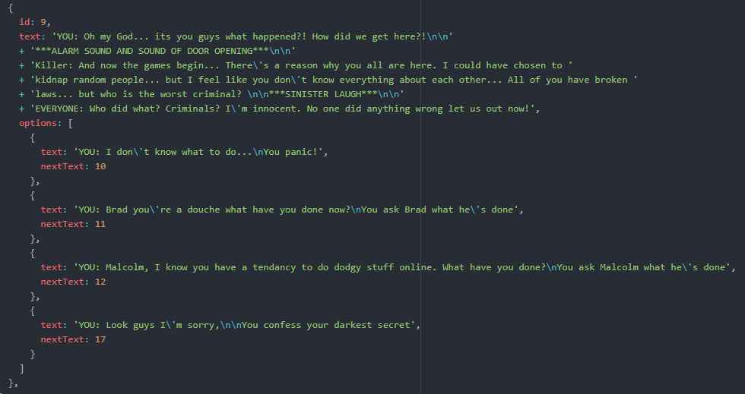
Text Game Mechanics
Each id has:
‘text’
Appears in dialogue box.
‘options’
buttons
Within each ‘{...}’ is a button which includes
‘text’ (options)
Appears in buttons.
‘nextText’
Specifies which id is shown when that option is clicked.
Operation of text adventure elements (2)

Slide 8
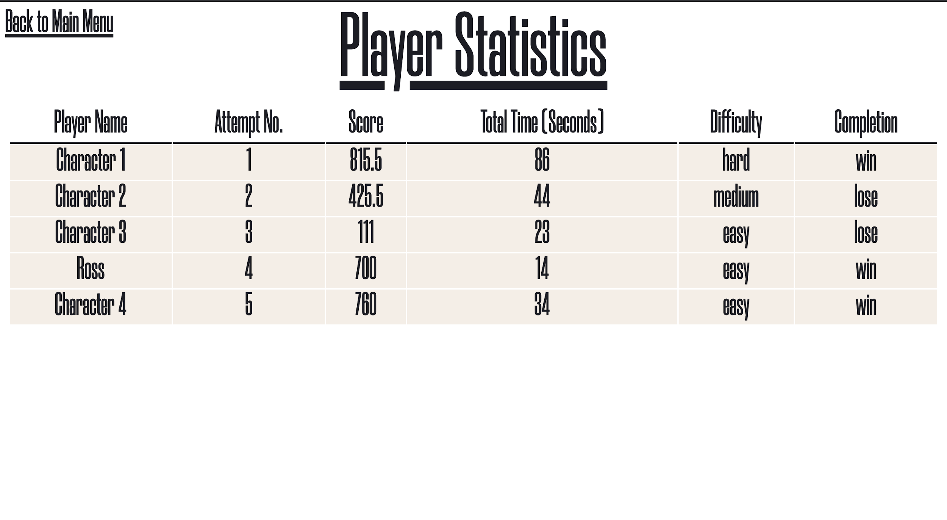
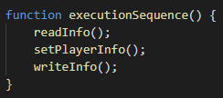
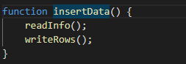
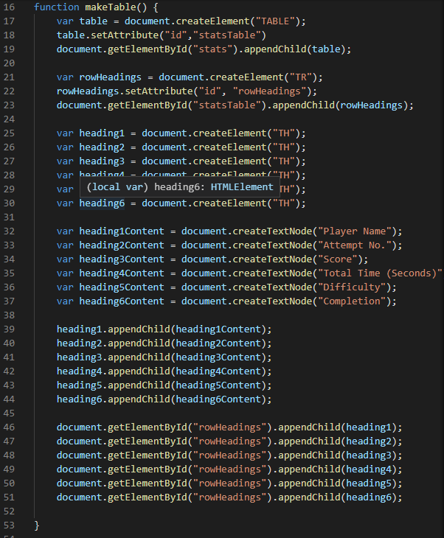
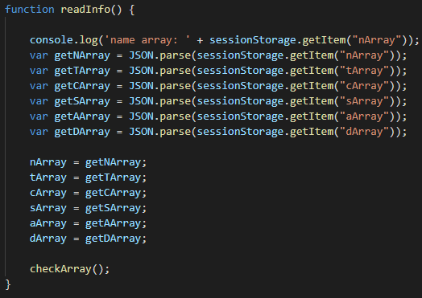
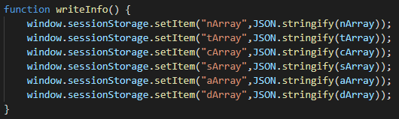
User Statistics
Using JSON methods parse() and stringify() in order to use arrays with session storage as session storage converts any arrays into only strings whereas using JSON allows us to sessionstore arrays then use .parse() to convert it back to a variable we can use
DOM Methods such as .createElement() and appendChild() were used in the creation of the table. Execution methods seen below are called in conjunction with other javascript files to ensure information
To record the total time for the attempt accurately, a timer starting from 0 counting up is used which is running in the background and starts as soon as the player presses ‘’Shall we begin….’
This along with all other values used in the player statistics page is stored in session storage
Statistics generated for the player

Slide 9
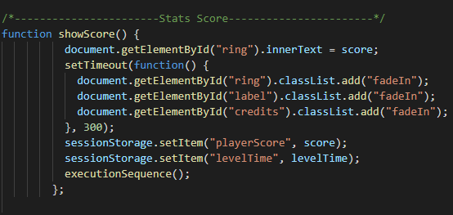
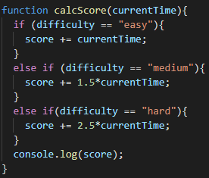
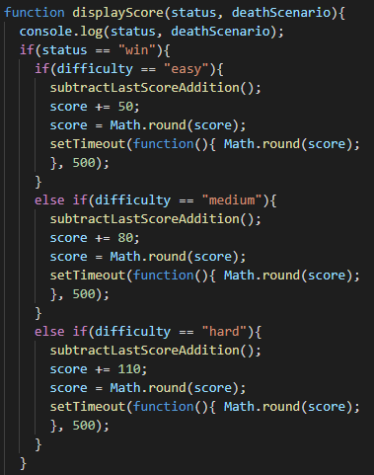
The score is added onto using two factors: a multiplier (depending on the difficulty) and the current time.
Upon starting the game the player will get a base score based on what difficulty they have chosen.
The score will be added onto after the user selects an option however if the wrong option is chosen, a score deduction will occur depending on which scenario has been met.
If the timer reaches zero however, the score the player will get will be zero.
End Game Scores
Easy - 50 + score from choices
Medium - 80 + score from choices
Hard - 110 + score from choices
Base Scores
Easy - 50
Medium - 80
Hard - 110
Difficulty Multipliers
Easy - N/A
Medium - 1.5
Hard - 2.5
Score Addition per Section
Easy - time
Medium - 1.5*currentTime
Hard - 2.5 * currentTime
Statistics generated for the player

Slide 10
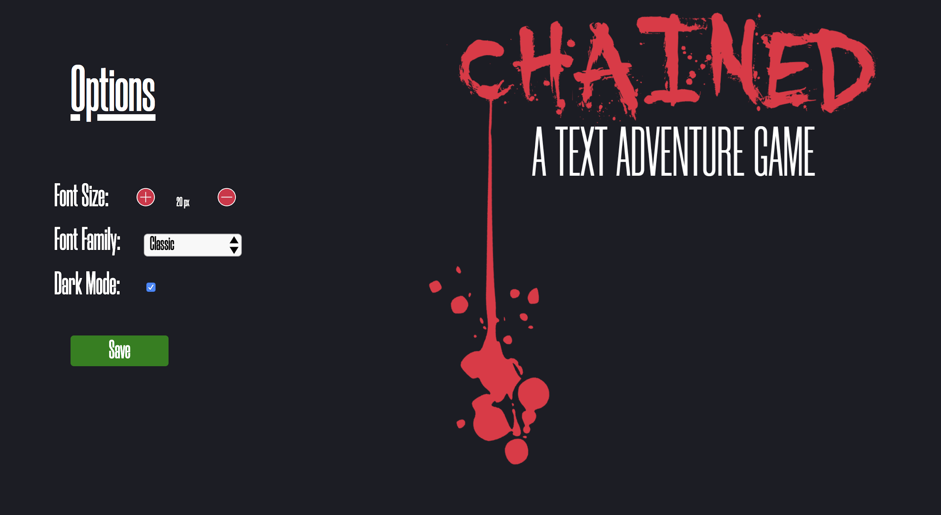
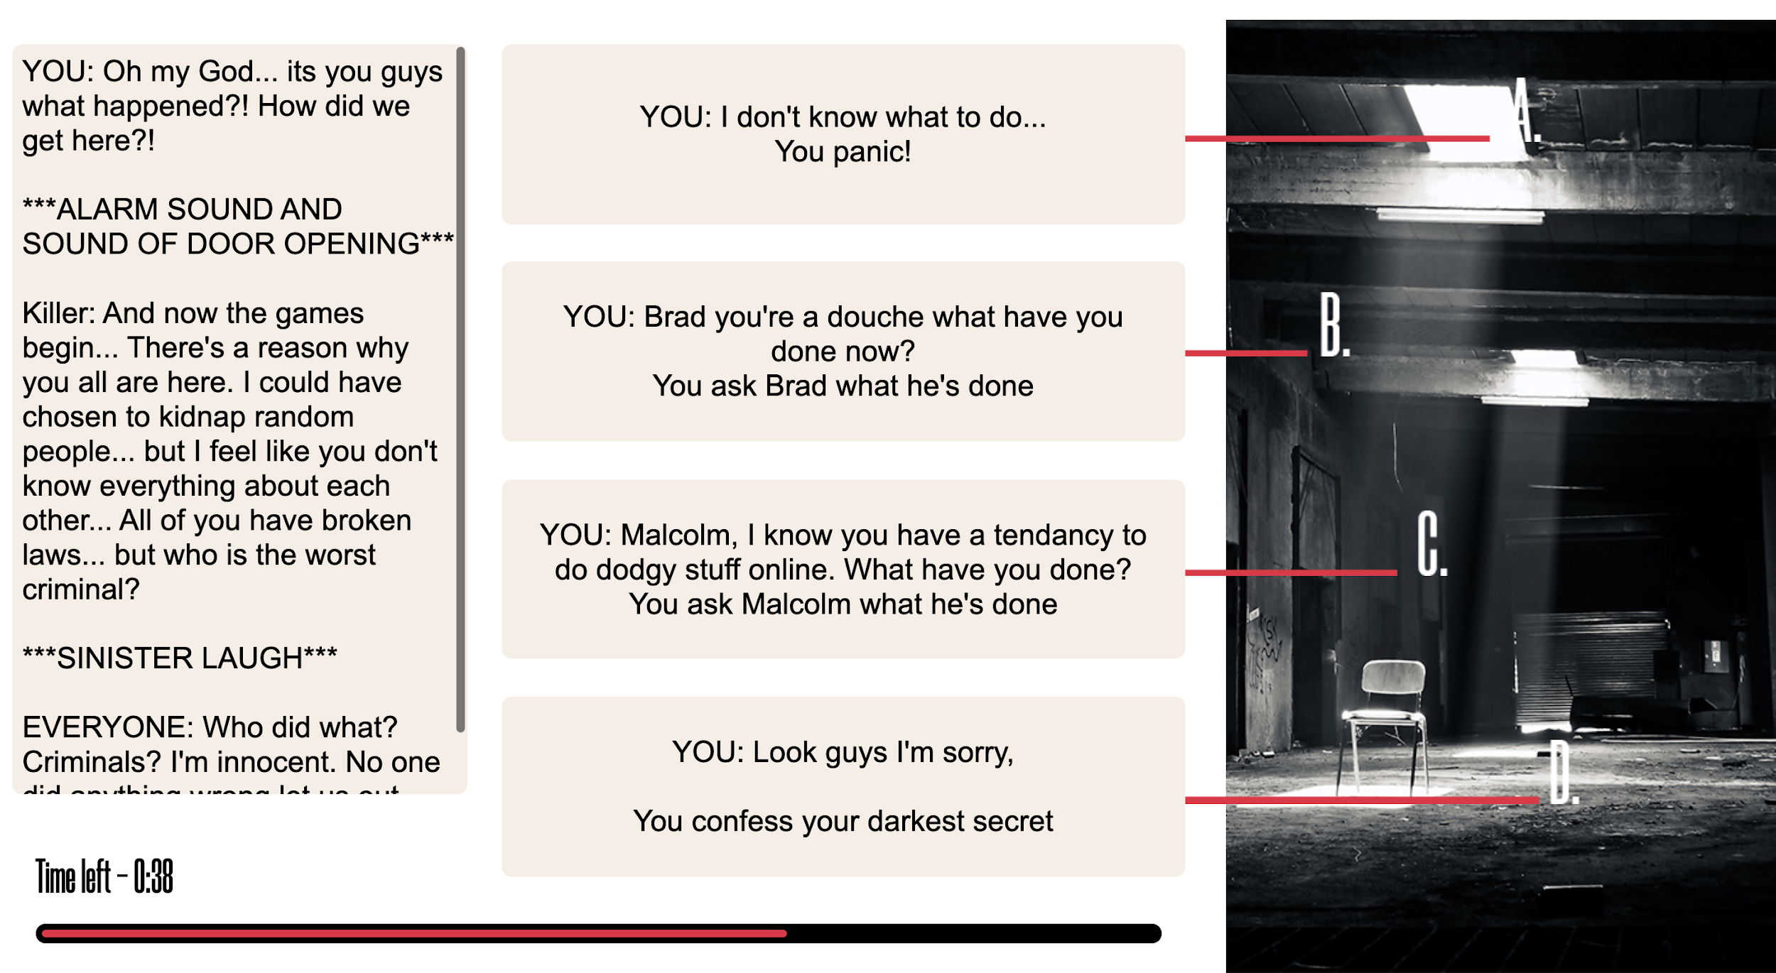
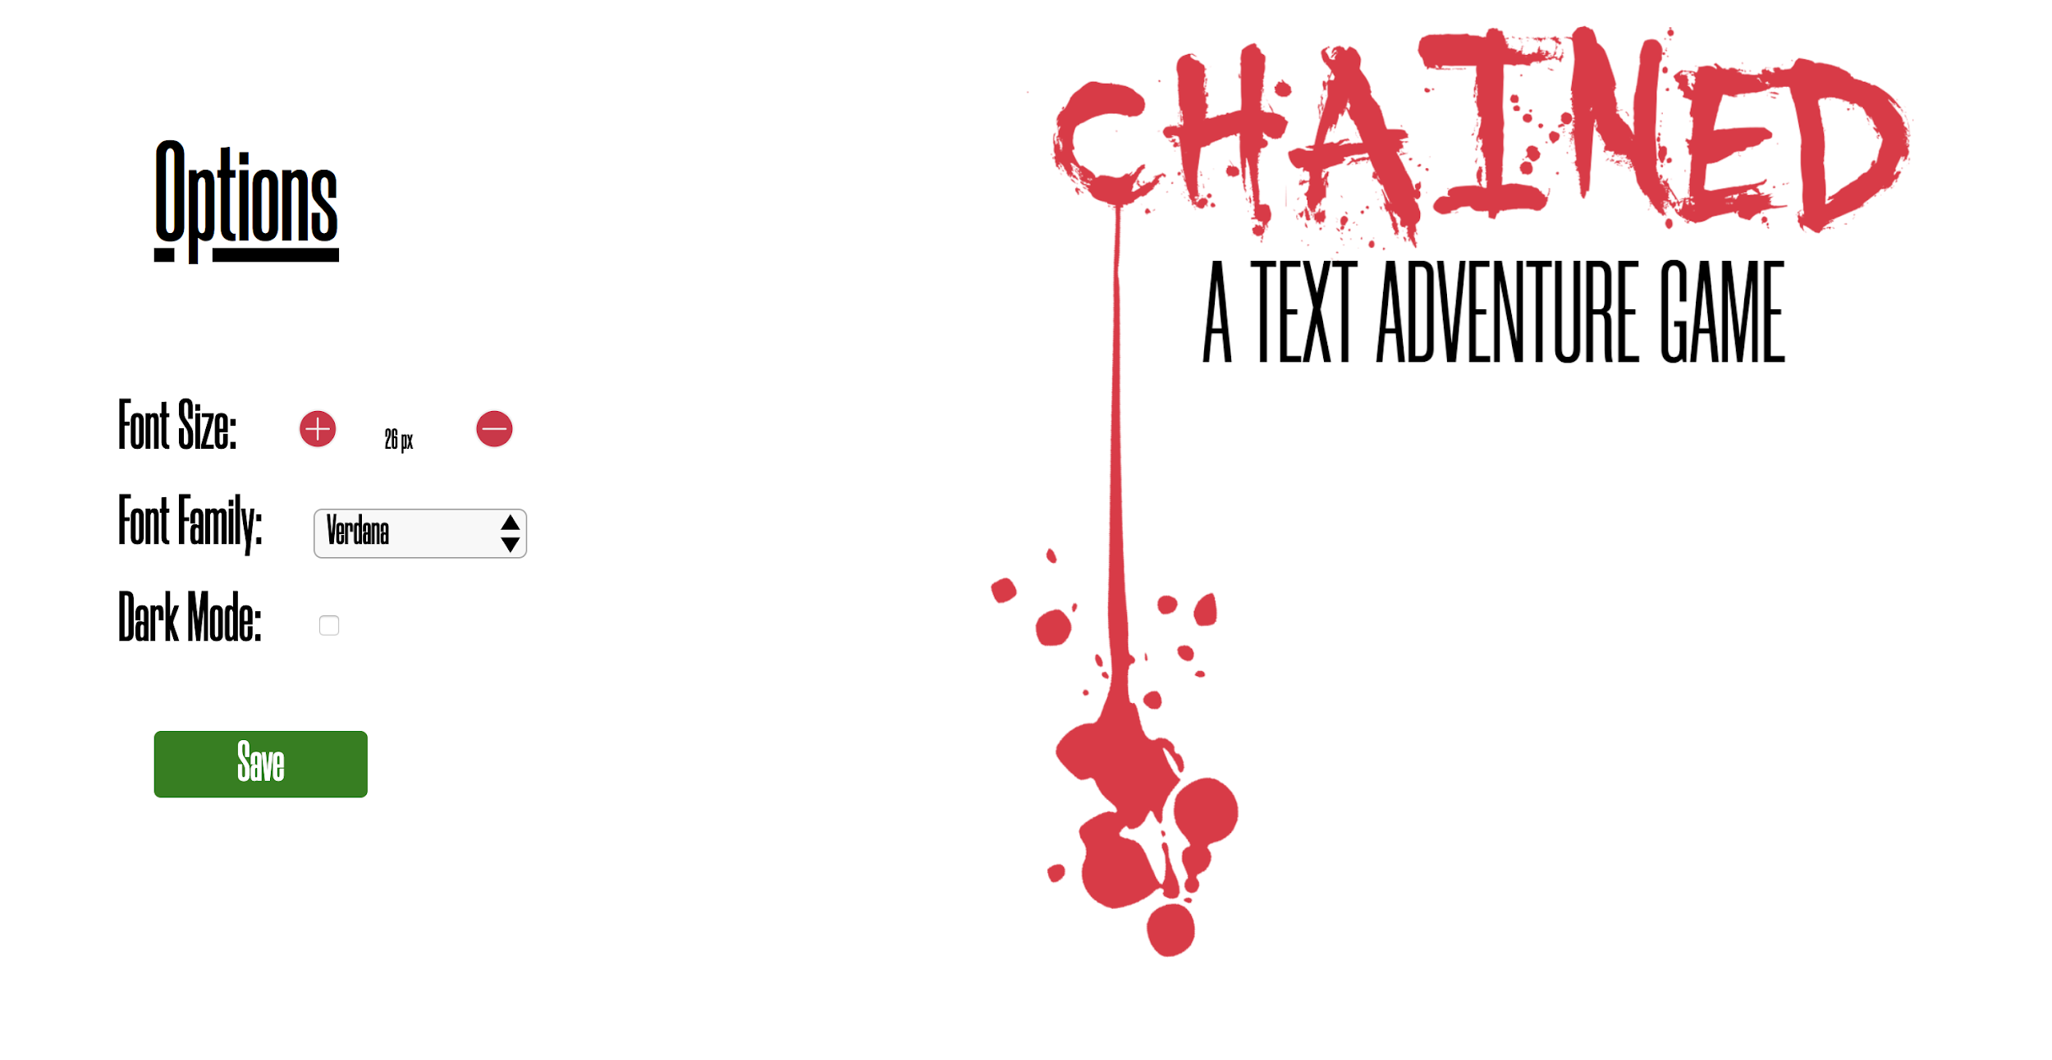
Options Page
Font size can be increased if user has poor eyesight. Font can also be decreased for use on devices with smaller screens
Font family can be changed for users that may find our ‘classic’ font difficult to read
Dark mode has been incorporated in our game to enhance visual ergonomics and reduce eye strain in dark lighting
Dark mode is enabled when the “Save” button is pressed
Figure above shows largest font size and the font family changed to Arial
All text has been inverted to white, including in our main image and silhouettes.
Background and buttons have all been changed to two shades of grey as seen on next page.
Operation of accessibility features (1)

Slide 11
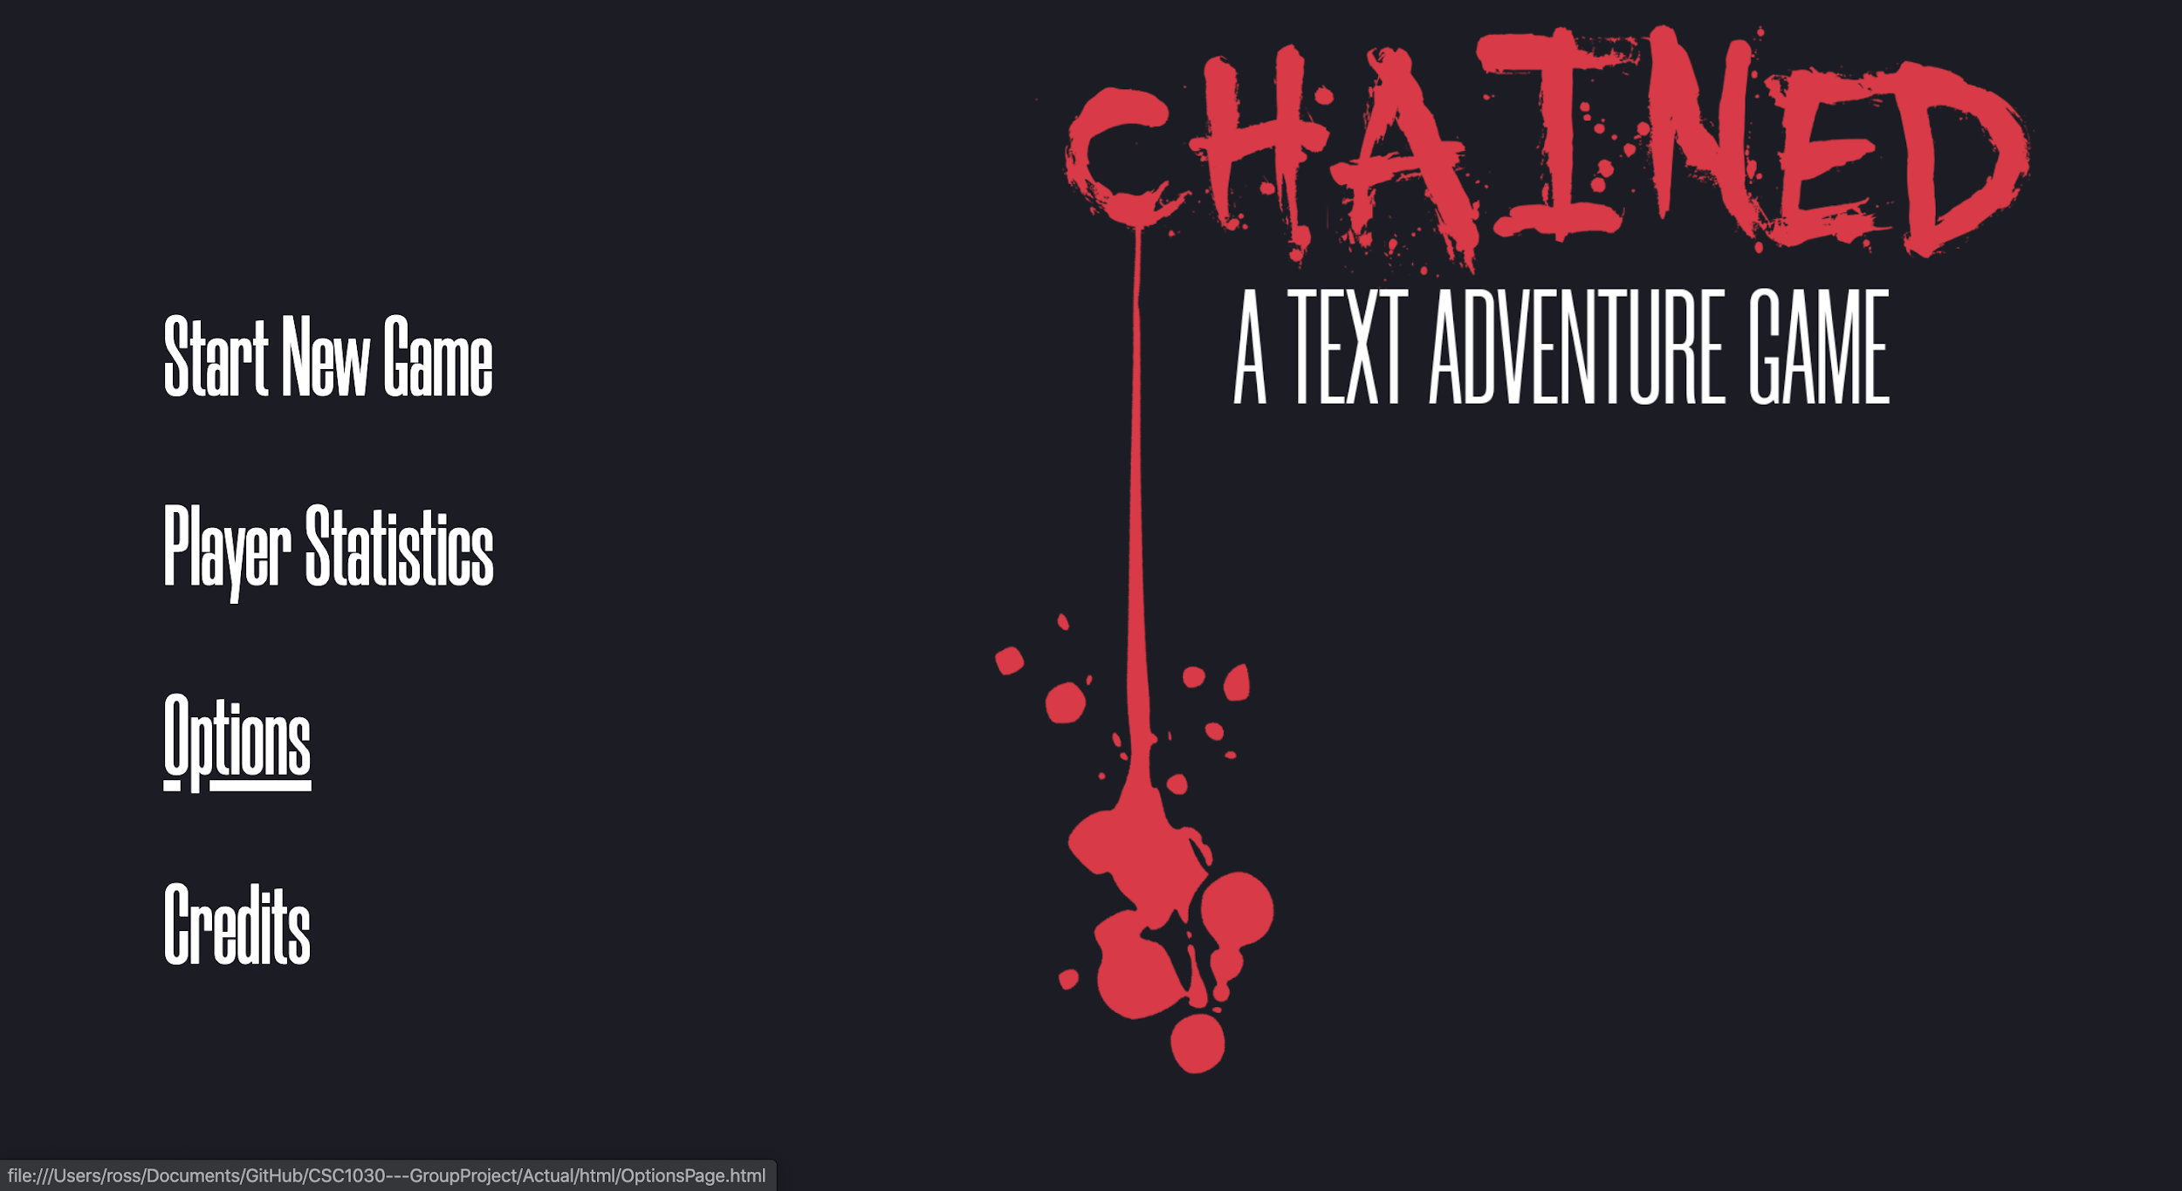
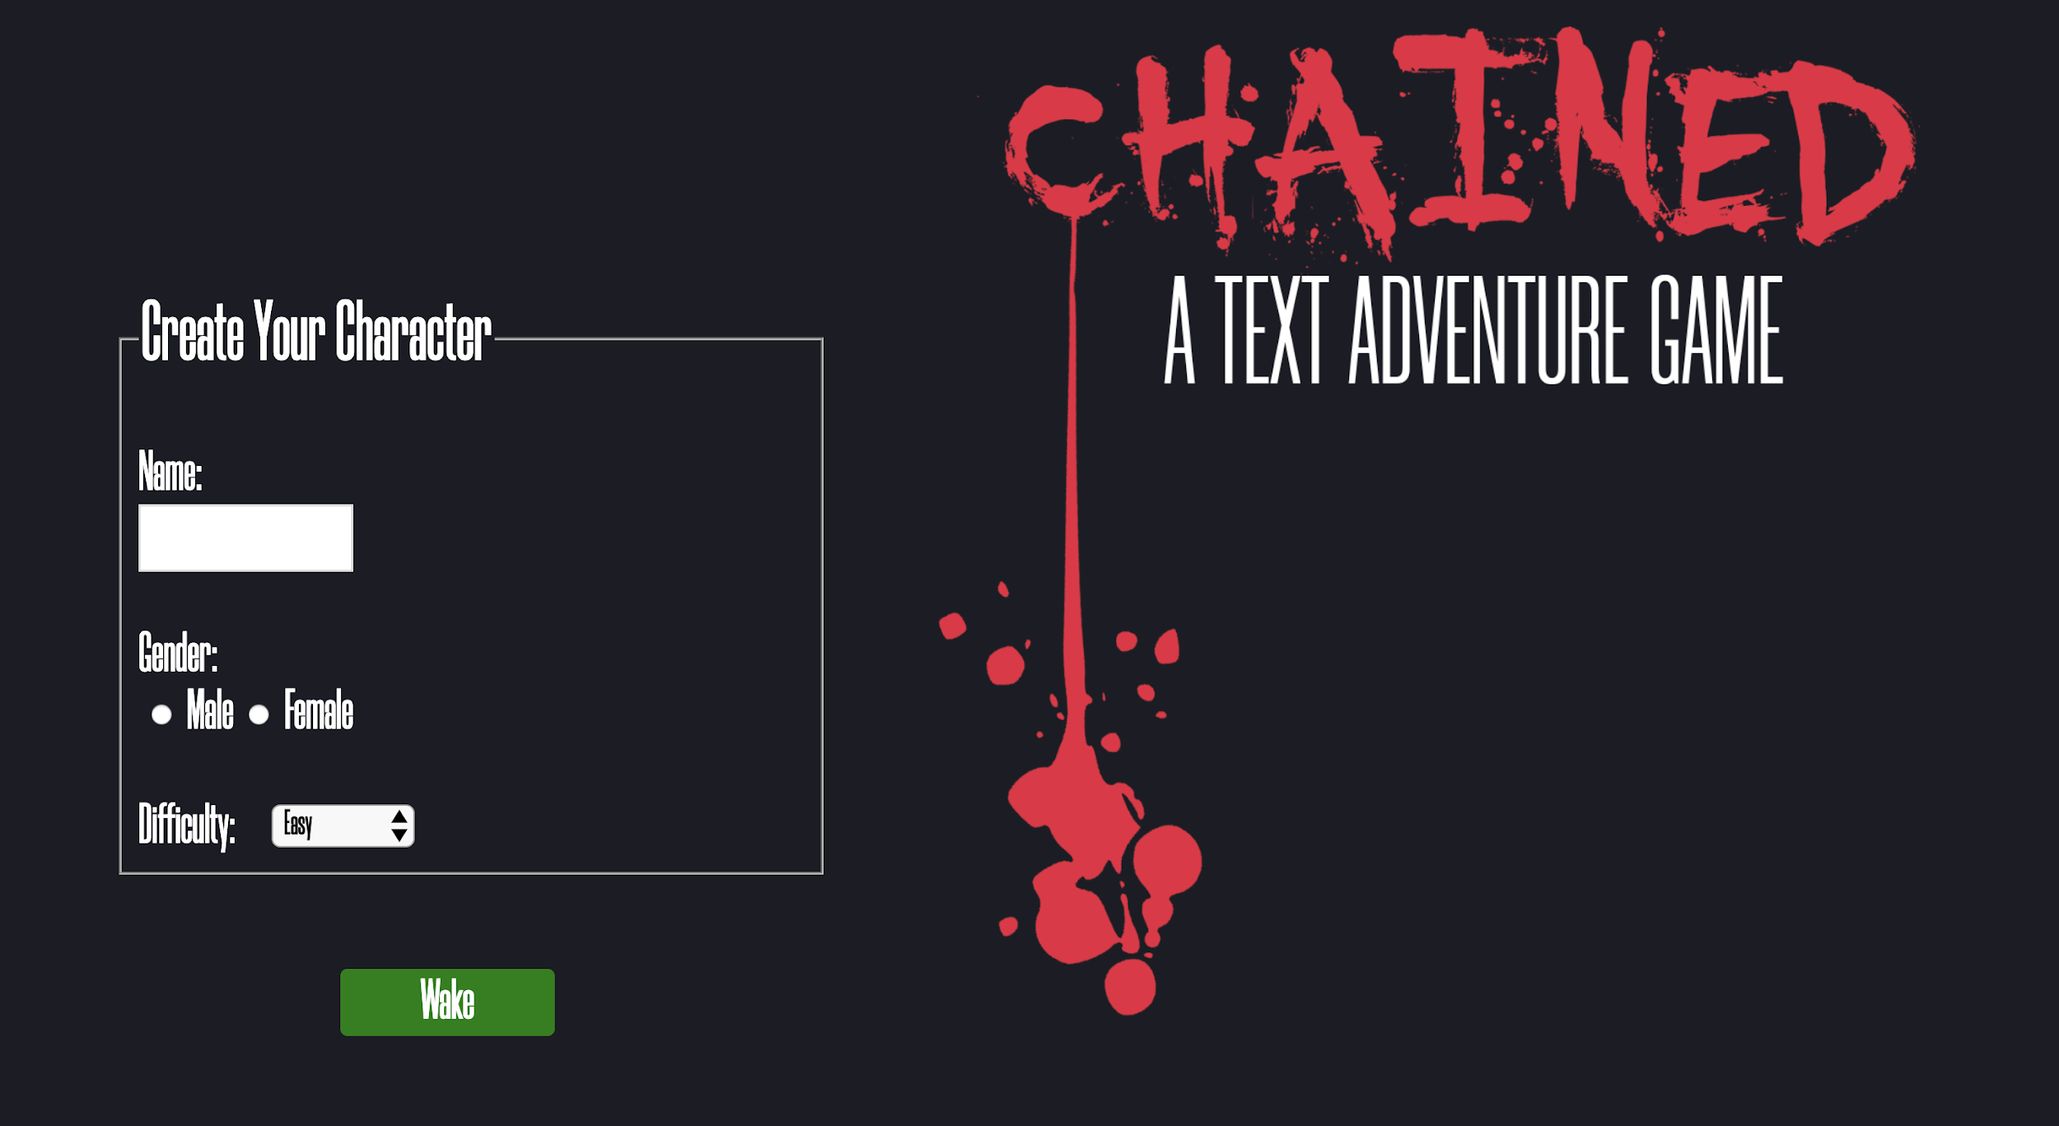
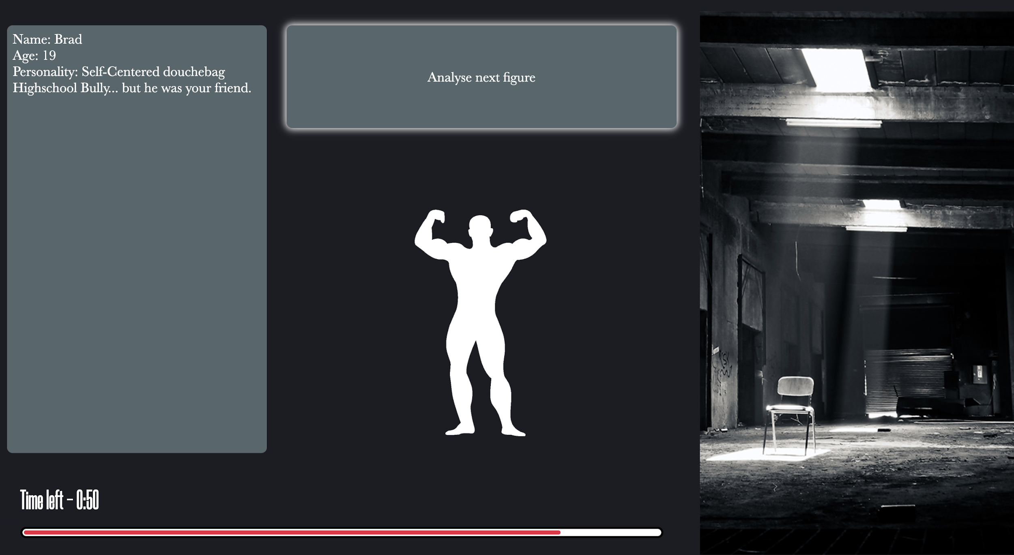
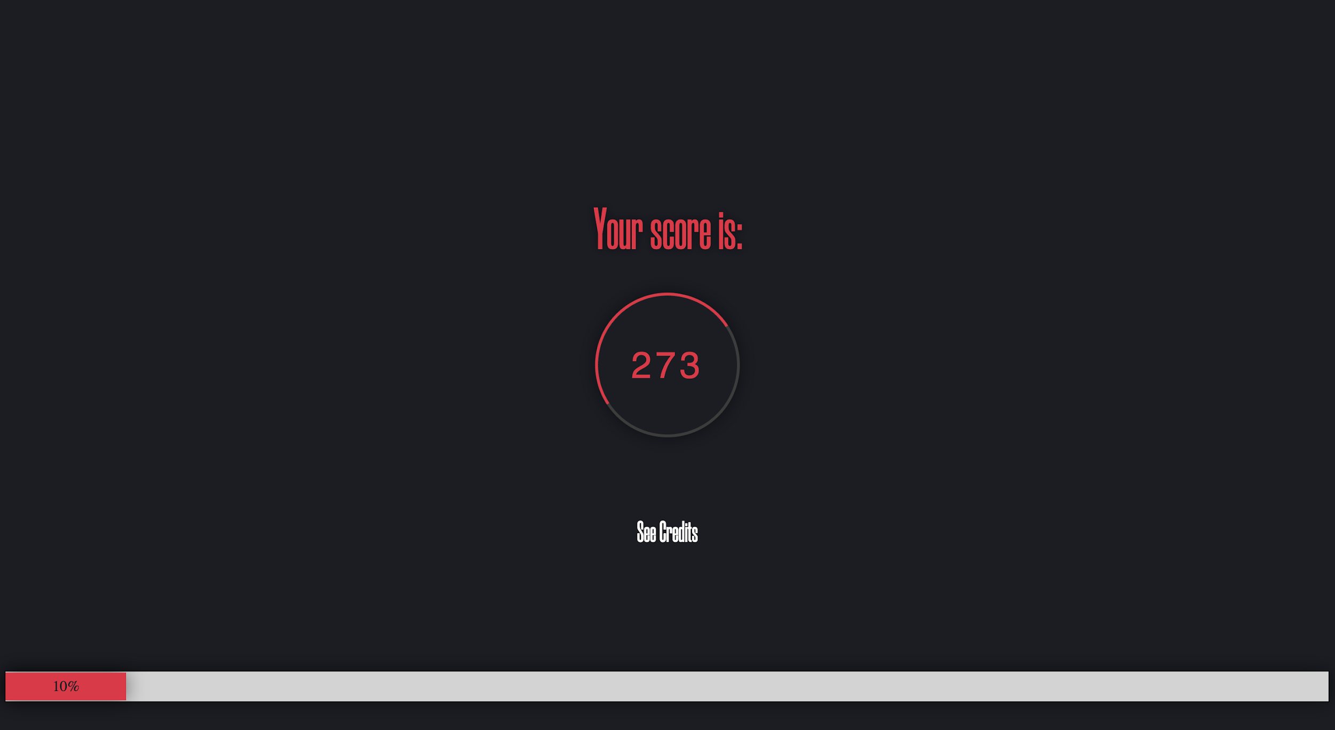
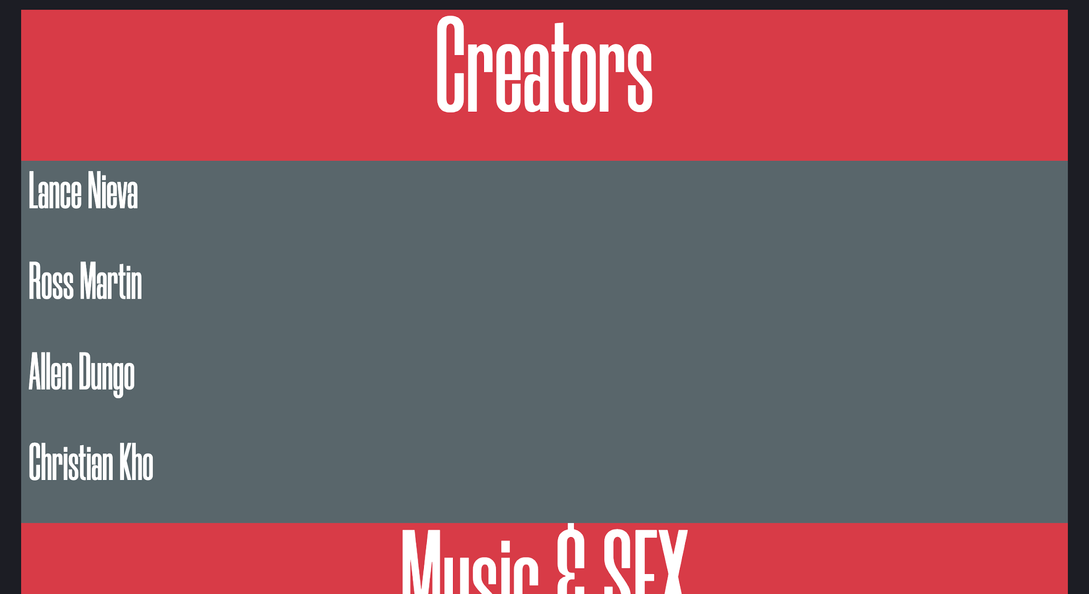
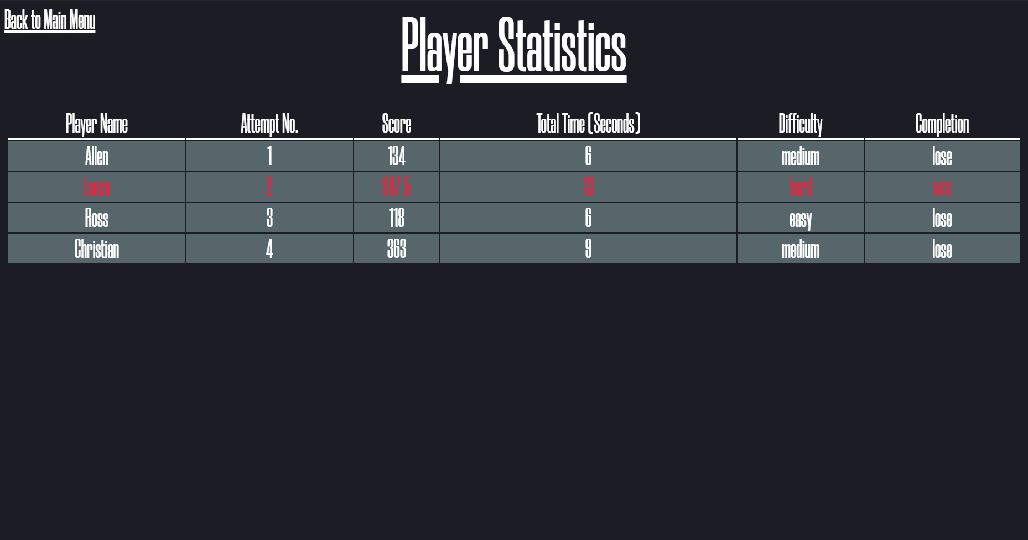
Operation of accessibility features (2)

Slide 12
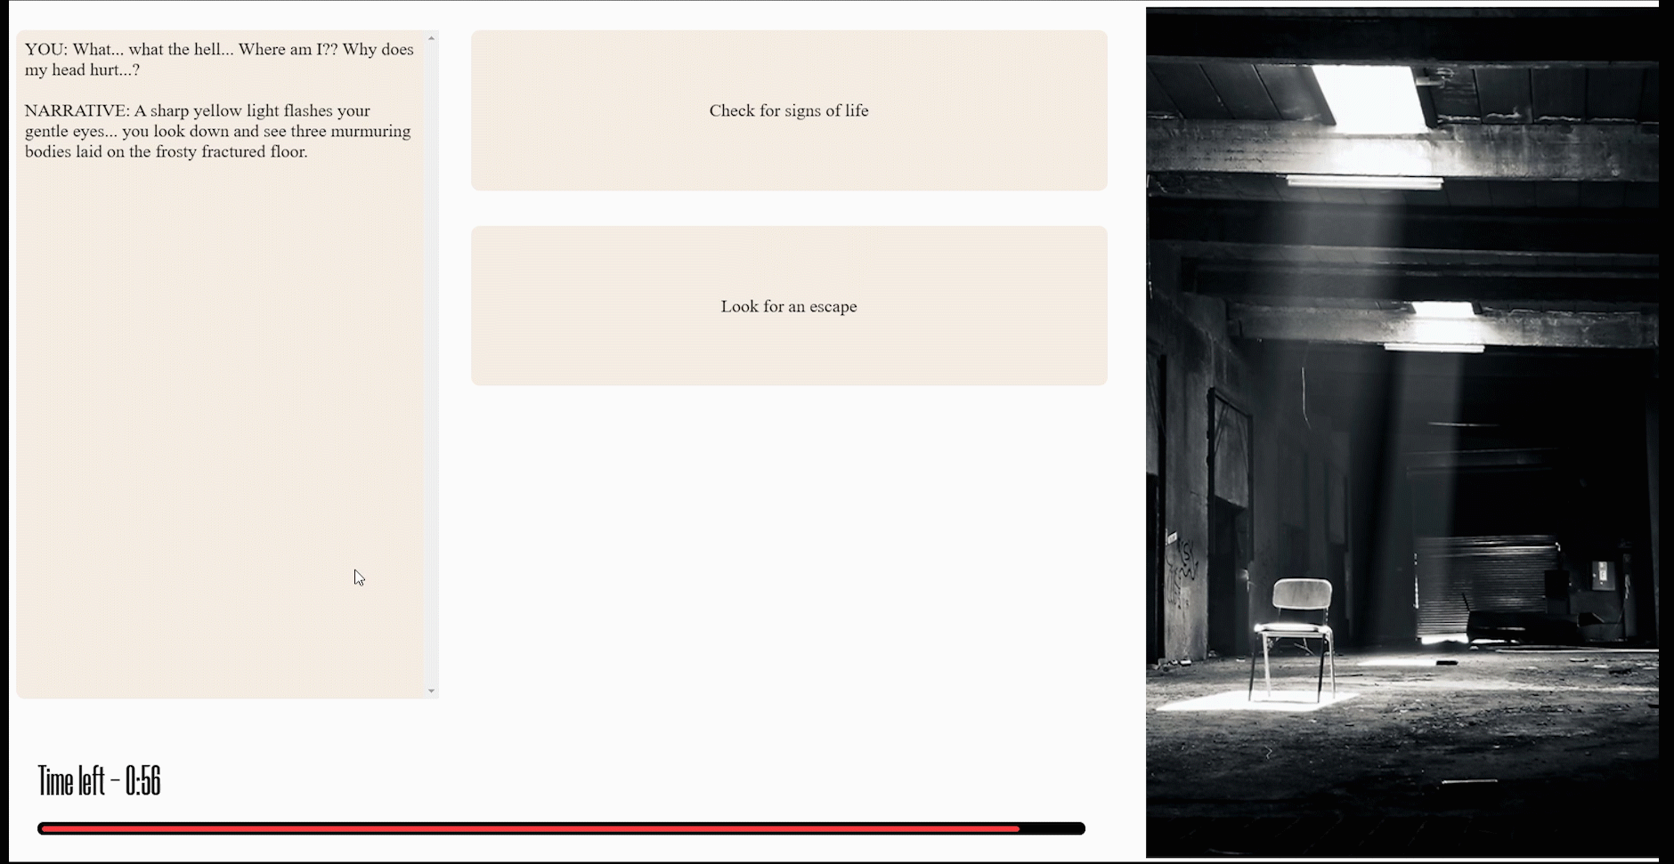
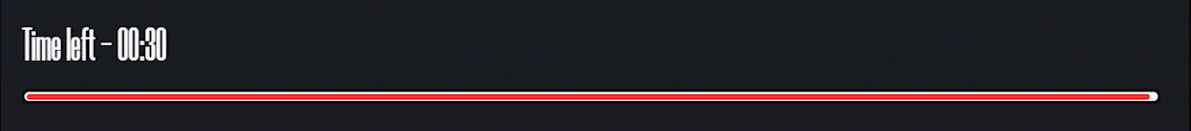
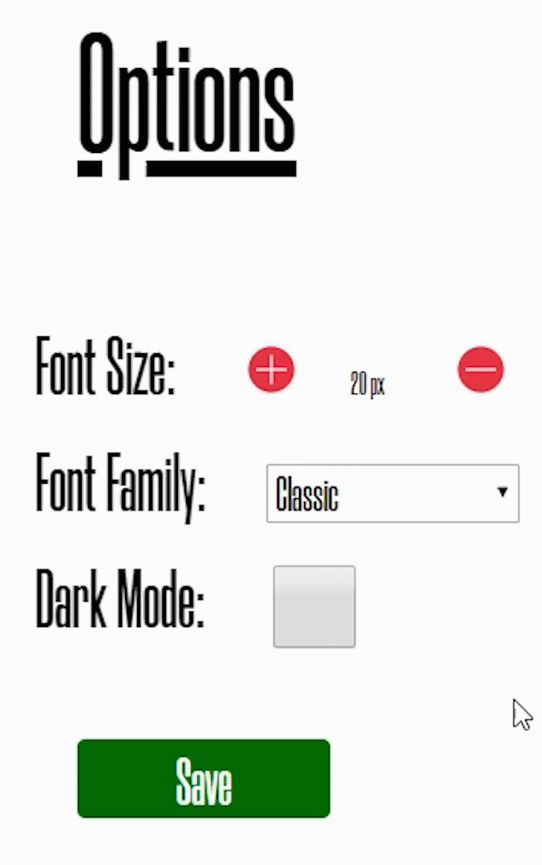
Time Implementation
The usage of text node IDs allowed us to easily implement and edit features at any part of the game such as the slide down curtain and silhouettes fading in at certain parts of the game.
This implementation of more complex features and visual effects further enhances user experience, to keep them fully engaged and immersed within the story.
Time is represented using two mediums: digital (Time Stamp) and visual representation of the time stamp (Time bar). The timebar utilises the value of the current value of the time stamp to allow for proper synchronization of the timebar and time stamp.
Text Game Mechanics
Accessibility and Customizability
As the user increases/decreases the font size, the previewed text between the buttons will increase/decrease to show a real representation of the font size. The dark mode feature also works across all pages of our game.
Top features of the game in terms of complexity / quality of user experience

Slide 13


Images
Music
Text Adventure Gameplay Music: Mattia Cupelia Free-to-use
All other music and SFX: Rocket Stock Royalty, Free-to-use
Due to Google Chrome’s autoplay privacy policy we added a music play button to the top right of every page
All images and music used have been acknowledged on the credits page and comply with allocated copyright regulations
Sources of media used throughout the game

